Slide 1
Git Branching

Slide 2
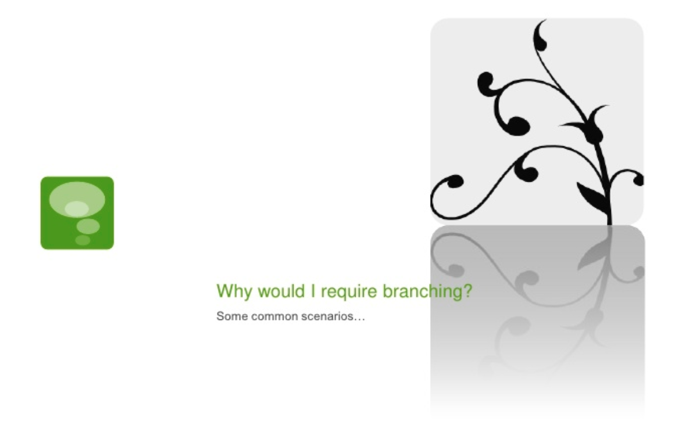

Slide 3
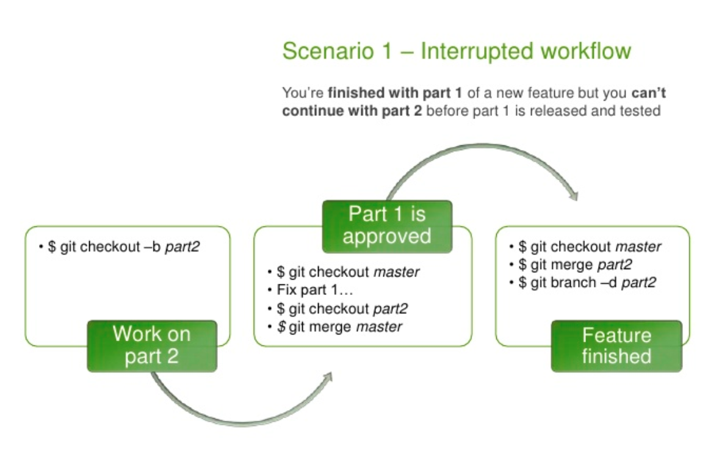

Slide 4
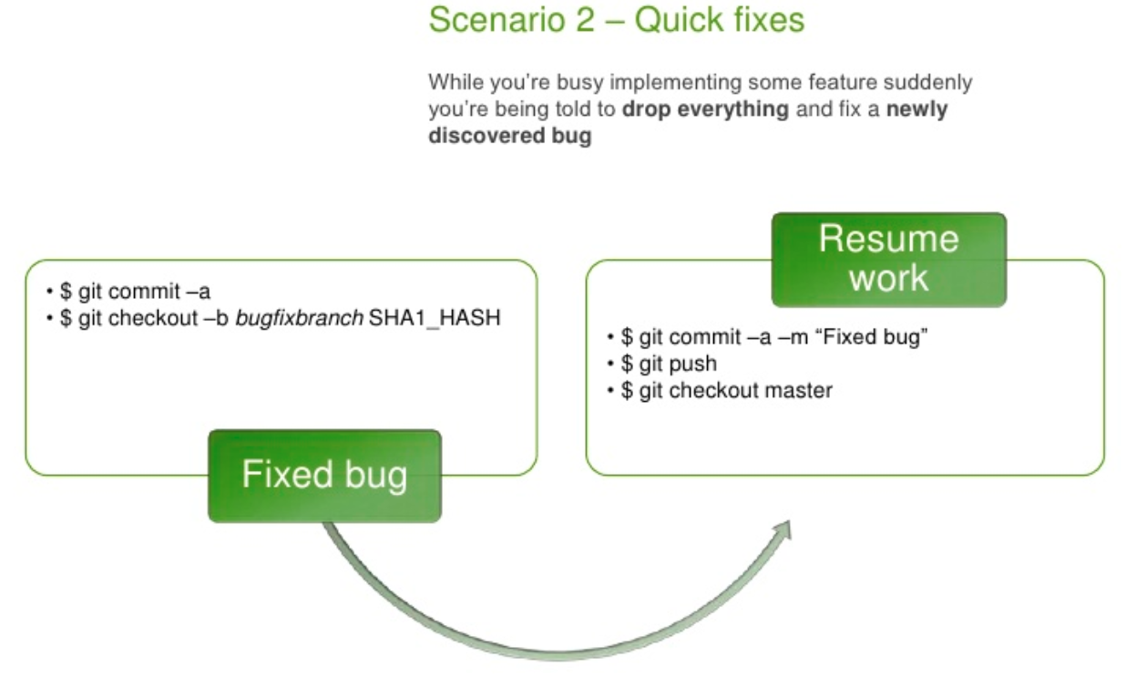

Slide 5
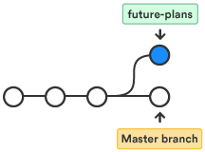
Git branch: List, create, or delete branches.
Run git branch
$ git branch <branch name>
(This will create a new branch into your local repository.)
$ git branch -a
(This will list all your branches i.e. local and remote. Also put an (*) before your current branch.)
Options
-d: --delete :
Delete a branch.
-m : --move :
Move/rename a branch and the corresponding reflog.

Slide 6
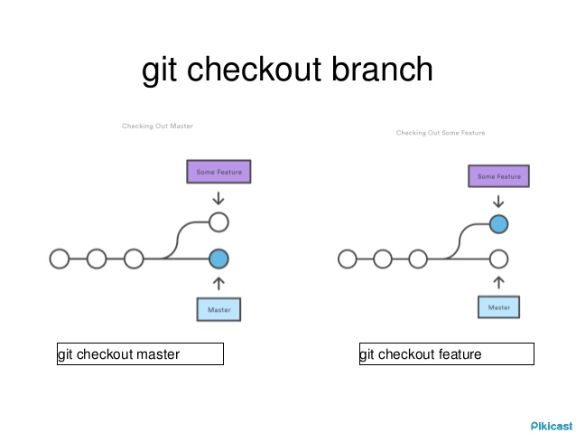
Git checkout: Switch branches or restore working tree files.
Run git checkout
$ git checkout <branch name>
(This will switch into a branch.)
$ git checkout -b <branch name>
(This will first create and then switch into that branch.)
Options
-f : --force :
When switching branches, proceed even if the index or the working tree differs from HEAD.
-B <new_branch>
Creates the branch <new_branch> and start it at <start_point>; if it already exists, then reset it to <start_point>.

Slide 7

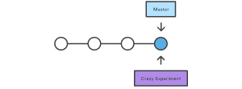
Git branch operations
git branch crazy-experiment

Slide 8
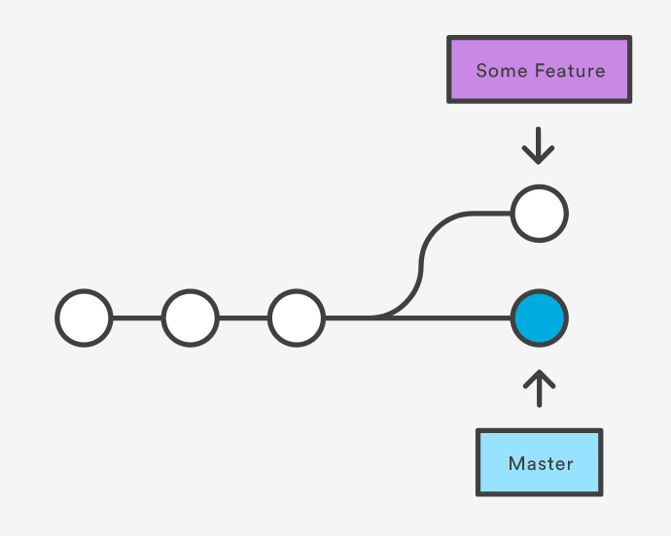
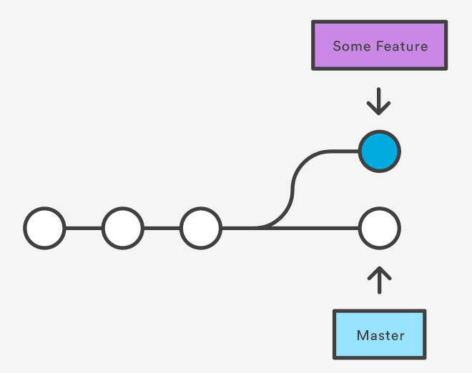
Git branch operations
git checkout Some Feature

Slide 9
Git branch operations
git branch -D crazy-experiment

Slide 10
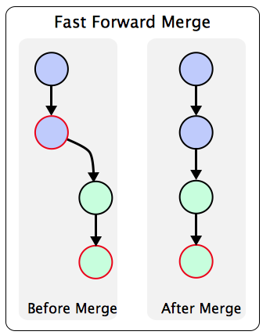
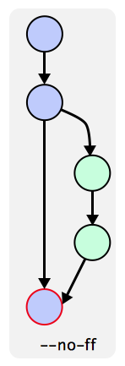
Git Merge
Notes:
http://www.bogotobogo.com/cplusplus/Git/Git_GitHub_Fast-Forward_Merge.php

Slide 11
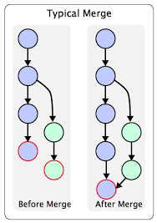
Git Merge
Notes:
https://www.atlassian.com/git/tutorials/git-merge

Slide 12
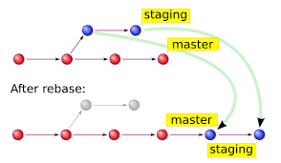
Git Rebase

